Slide 1
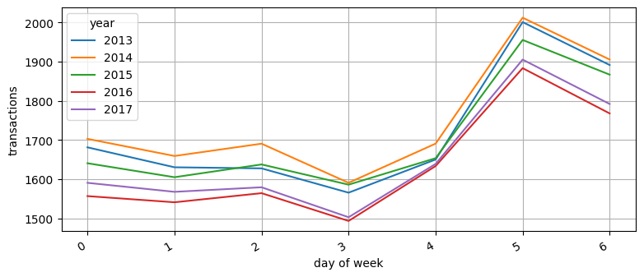
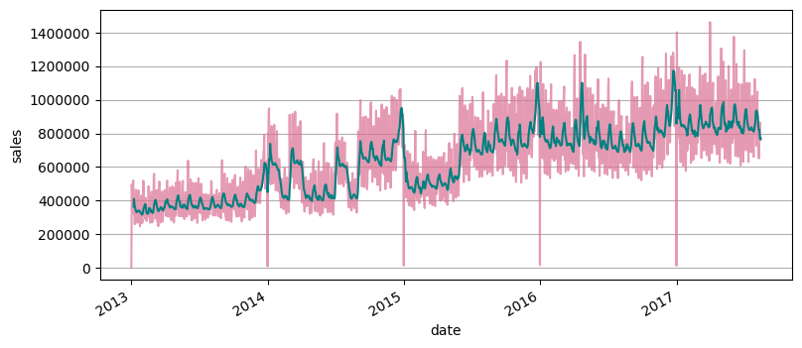

Data Fields:
id Int – Dropped Unique identifier
date YYYY-MM-DD – from 2013 to 2017
store_nbr Category – One-Hot Encoded Identifier for the store sold at
family Category – One-Hot Encoded The general type of product E.g. hardware, deli
sales Float – Target Amount of product sold, varies by product
onpromotion Boolean – Passthrough
Data Exploration & Preprocessing:
Transactions by Day of the Week
Sales over the Years
Another Topic:
Another Topic:
Evaluation Metric:
Root Mean Squared Logarithmic Error
$$\sqrt{\frac{1}{n}+\left(\sum_{i=1}^{n}{(log\left(1+{\overline{y}}_{i}\right)+\log{{\left(1+y_{i}\right))}^{2}}}\right)}$$
Scores (lower is better):
Dummy: 4.37969
Linear Regressor+: 2.15884
Linear Regressor: 1.66704
CatBoost: 1.52782
CatBoost + Lin Reg: 0.91495
2017 Data Only: 0.81687
Data Process 2: 0.54769
Other Included Data:
Oil Prices Ecuador’s economy heavily relies on oil trade, influencing market prices on groceries
Holiday Events Any local or national holidays that likely influence sales and other transaction data
Transactions General sales trends for each store, useful for normalizing sales numbers per store
Stores Location, size, and other logistical information about each store
Anomalous Data:
A major earthquake struck Ecuador on April 16, 2016 which effected sales prices for a number of weeks.
We tested with a smaller set of data (see 2017 Data Only model) to see the effect on the model’s performance.
USU CS 4320: Machine Learning, Fall 2022
Store Sales in Ecuador
Corbin Park, Charisse Spencer

